Slide 1
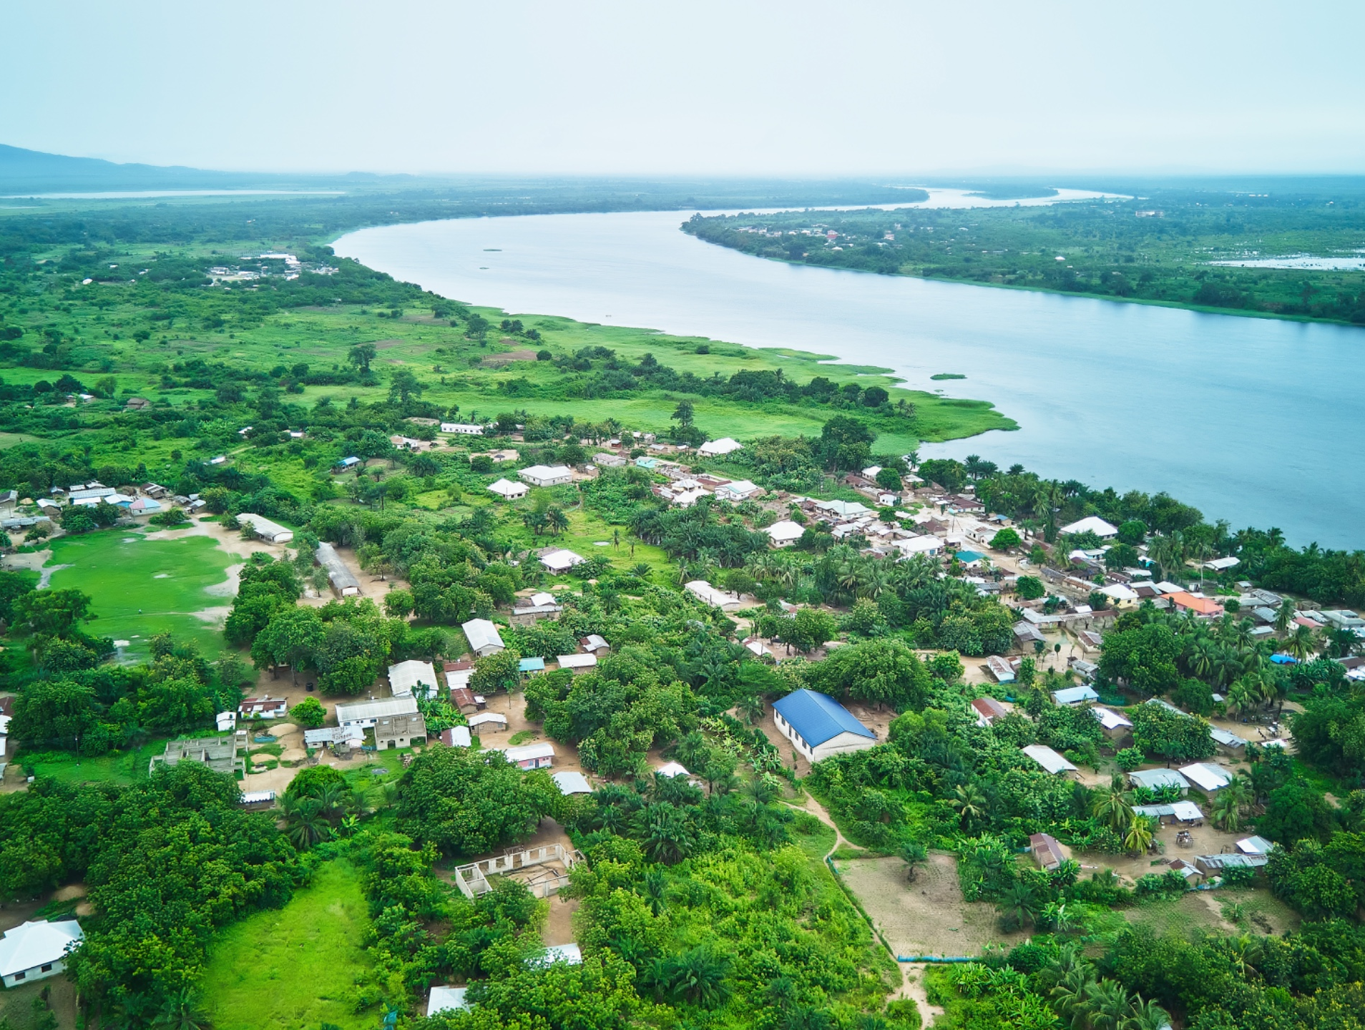

July 2024
Schistosomiasis Management Project in the Volta Basin: Strategic Partnerships and Digital Innovation
Elizabeth Kisson | Public Health Section | E&SDD
Volta River Authority
Notes:
Leveraging Partnerships & digital Innovation to improve and add value to Lives

Slide 2
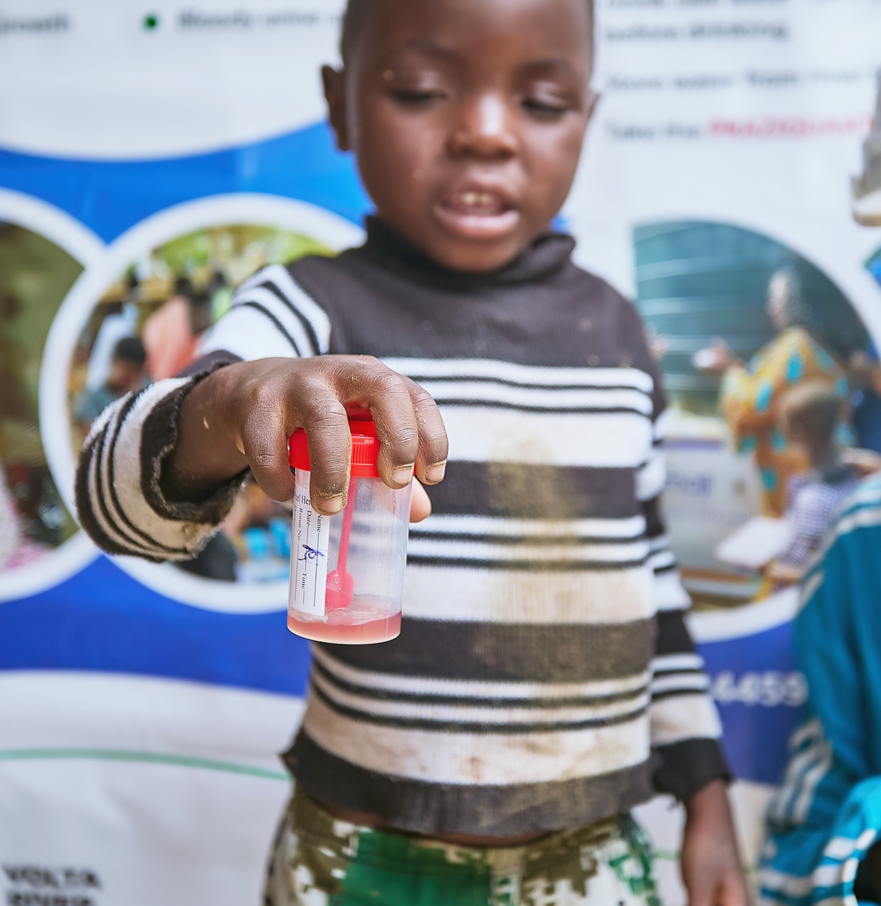
Outline of Presentation
Telling the VRA Schisto control Story
Profile of VRA
Section 1
Why the Public Health concern?
Section 2
Get to know about Schistosomiasis
Section 3
How PM was applied to Schistosomiasis control
Section 4
Digital Innovation in Action
Section 5
Conclusion & Call to Action
Section 6

Slide 3
PROFILE OF VOLTA RIVER AUTHORITY (VRA)
VRA established on April 26, 1961, to generate, transmit and distribute electricity under the Volta River Development Act 46, 1961 of the Republic of Ghana.
Transmission and distribution functions hived-off to Ghana Grid Company (GRIDCo), and Northern Electricity Distribution Company (NEDCo) respectively.
1
2
VRA owns and operates an electricity generation capacity of 2,547MW. Akosombo and Kpong Hydro Generating Plants have 1,020MW and 160MW respectively. 1,330MW Six (6) No. Thermal plants in Aboadze and Kpone. Complemented by a 2.5MW Solar PV Plant at Navrongo and a 6.5MW Solar PV Plant at Lawra, 13MW and 15MW Solar PV at Kaleo.
ESTABLISHMENT
OPERATIONS
4
Section 13 (1) mandates VRA to safeguard the health and safety of its staff and dependants and inhabitants of the lakeside area while Section 14 gives VRA Local Authority over Akosombo Township.
3
Section 10e mandates VRA to develop Lake area for the health and well being of inhabitants and people living along the Lake.
LOCAL AUTHORITY
OTHER
FUNCTIONS

Slide 4
VRA’s Commitment to Public Health Issues
VRA carries out interventions that mitigate adverse environmental, health and social impacts associated with construction and operation of its power plants on project affected communities.
VRA has an Environmental Management Plan Steering Committee led by the Environment & Sust. Dev’t. Dep’t. and made up of staff from Hydro Generation, Engineering, Audit, Finance, Procurement and Legal Departments.
Committee meets bi-annually with Stakeholders from project impacted communities.
Target: Reduce prevalence of Schistosomiasis in endemic communities within operational areas of VRA by 10% annually.

Slide 5
Background - Why the Public Health concern?
Rapid River flow rate during pre- impoundment of dam
These Aquatic weeds serve as sanctuaries for Schistosomiasis disease vectors and reduce socio-economic activities
Rate reduced significantly after damming leading to proliferation of aquatic weeds
Schistosomiasis is now of major Public health significance in the Volta Basin unlike during pre impoundment
Notes:
Why not concentrate on your core business of power generation? VRA’s role is not just power, but make public health impact

Slide 6
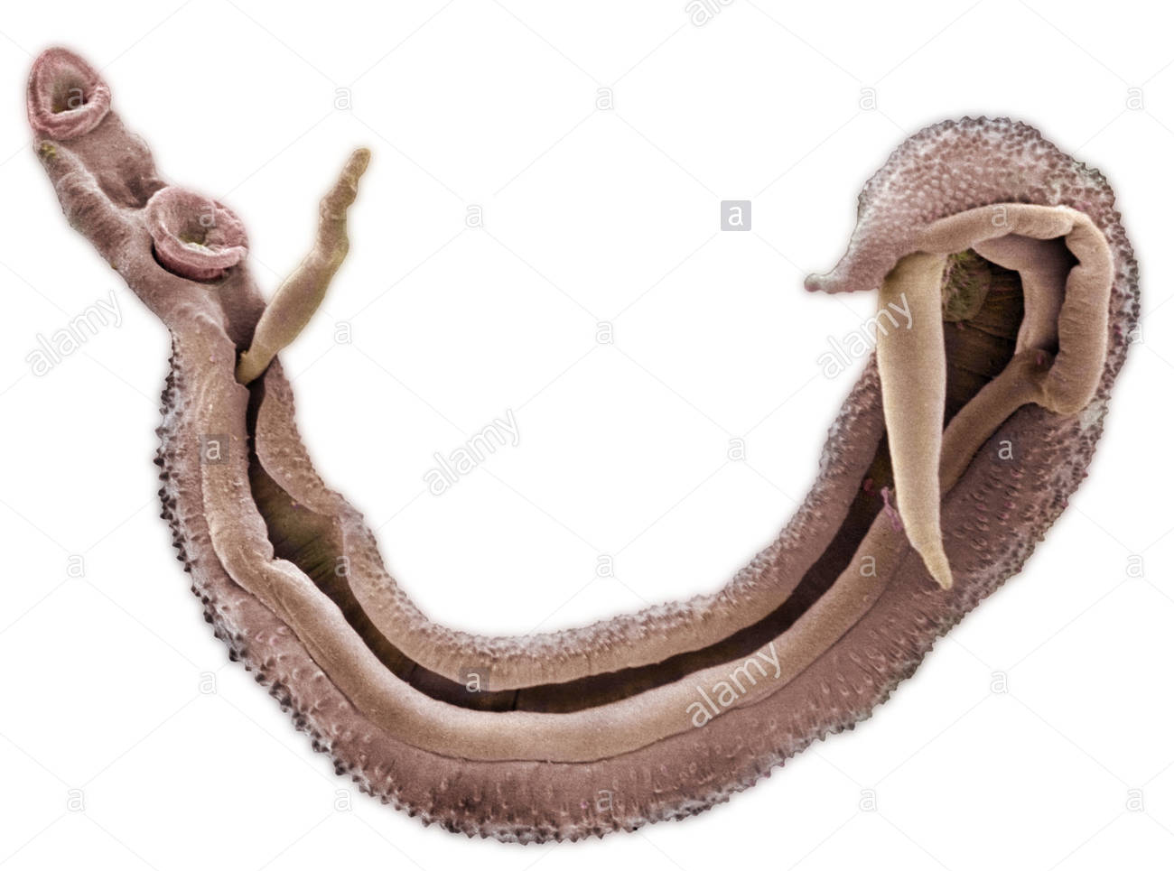
WHAT IS SCHISTOSOMIASIS? (BILHARZIA)
A tropical parasitic disease requiring preventive treatment of over 251 million people worldwide.
Second only to Malaria in terms of devastation
Affects 1.6million people along the Volta Lake
Two (2) major forms of schistosomiasis – intestinal and urogenital (Urinary) – caused by 5 main species of blood fluke (worms).
Praziquantel 600mg Tablets used for treatment at 40mg per 1Kg bodyweight or per WHO dose pole measurements.

Slide 7
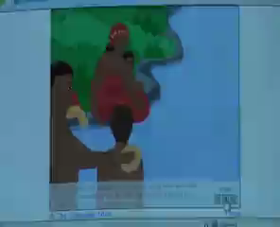
Life Cycle of Schistosomiasis (Animation)

Slide 8
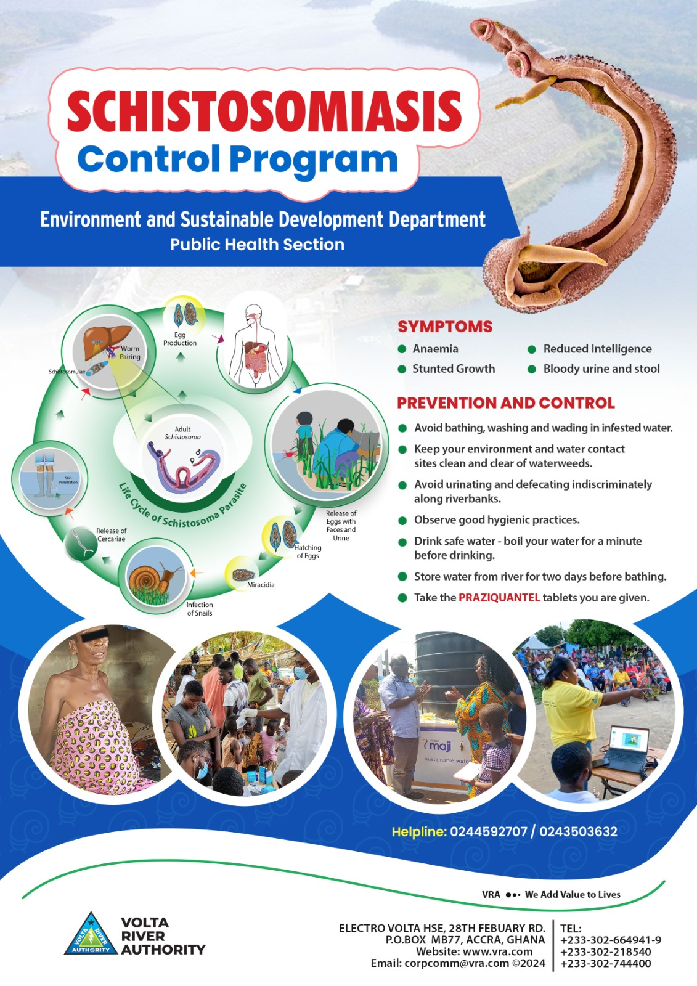
Schistosomiasis Management Project
Mass Drug Administration
Control of Host Snail Population
INTEGRATED APPROACH
Reducing contact with infested water
Health Education & Awareness Creation

Slide 9
What has been the major challenge?
A fluctuating trend of disease prevalence over the years, reflecting multiple re-infections along the trajectory.
Re-infection scenarios could be attributed to time lags in the administration of interventions as well as limitation in geographical and population coverage.
Desired consistent reduction in disease prevalence, leading to gradual reduction in prevalence level or preferably, elimination of the disease over the years not achieved.
3
Notes:
Understanding the Challenge and rethinking our strategies

Slide 10
Strategic Partnerships
& Stakeholder Engagement
Stakeholder engagement was a key PM tool – it was the heart of our success strategy
With clearly defined roles
Add mark here

Slide 11
GHS STRATEGIC PARTNERSHIP objectives
1. GHS shall treat Schistosomiasis within VRA impacted communities along the Volta Basin on behalf of VRA
5. Contract Duration is 1yr from date of execution of contract and to be renewed based on satisfactory performance
Treatment of Schistosomiasis in communities impacted by the operations of VRA
4. GHS to collaborate with VRA in the treatment of people affected by Schistosomiasis in VRA operational areas to ensure that many more schistosomiasis endemic communities are covered and managed in a sustainable and cost-effective manner
2. Agreement Ceiling
for services rendered is GH¢ 482,861.25, exclusive of Taxes for a year
3. GHS shall perform the services specified in proposals.

Slide 12
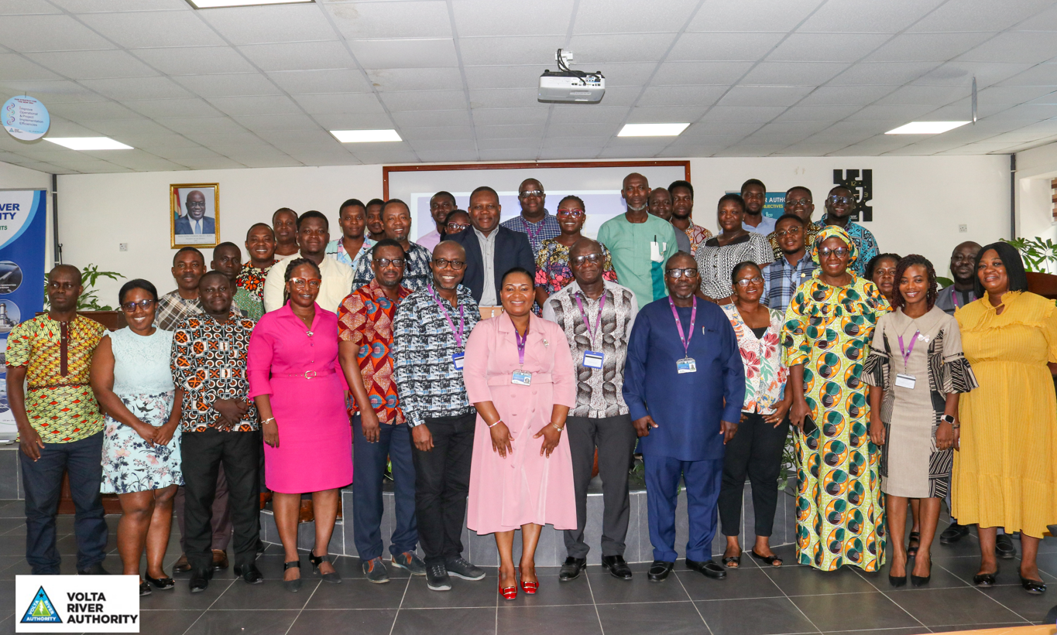
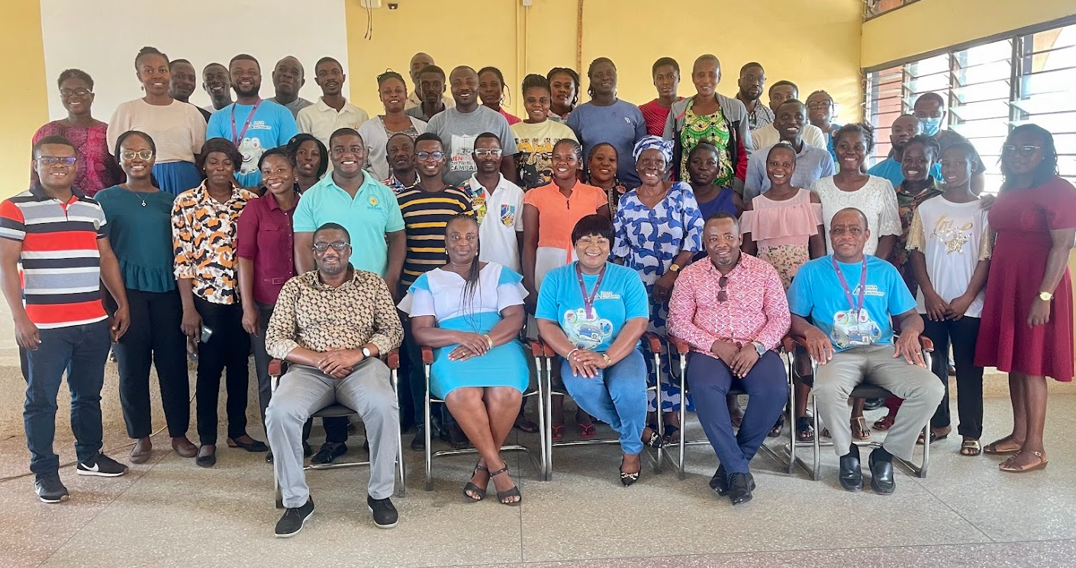
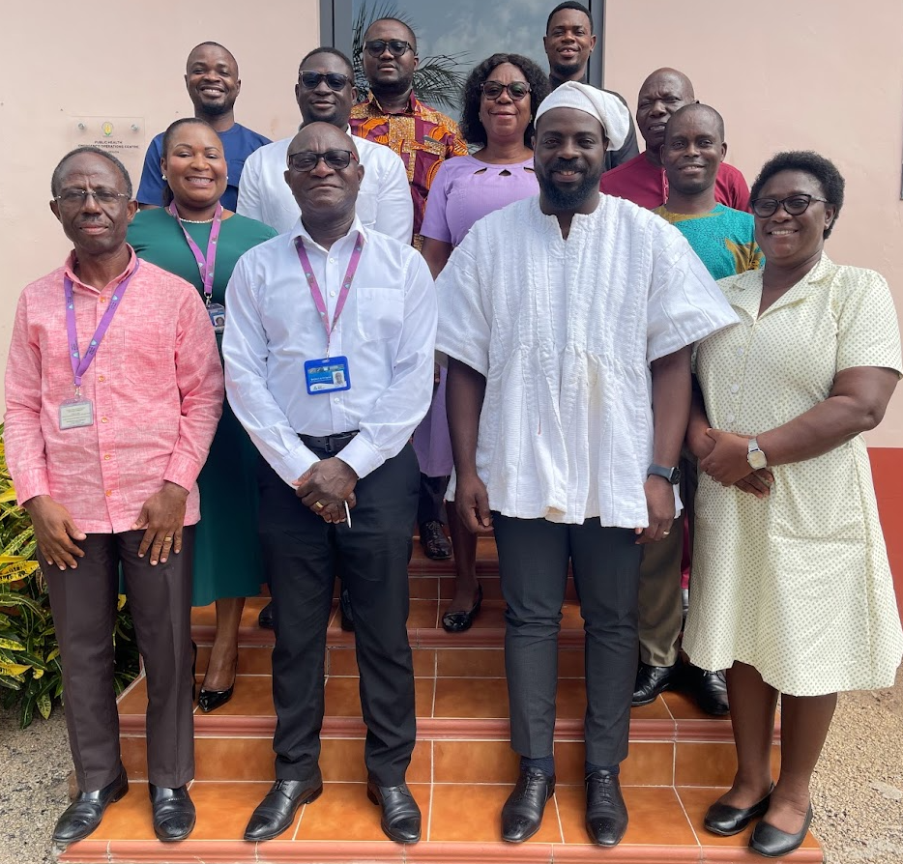
Greater Accra &
Volta Regional Health Directorates
- Ada East,
- Shai Osudoku,
- Central Tongu,
- North Tongu,
- South Tongu and
- Asuogyaman District Health Directorates
as well as the
- Kpando Municipal Health Directorate
University of Health &
Allied Sciences
to conduct implementation
research to model
context-specific interventions
for optimum results.
Chiefs &
Community Leaders

Slide 13
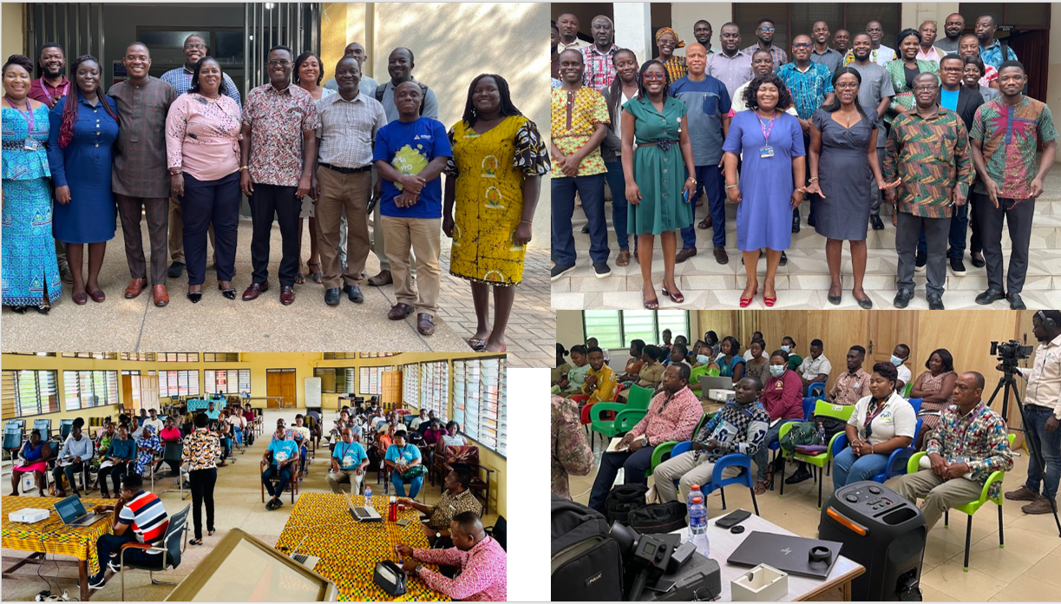
Training and Capacity building

Slide 14
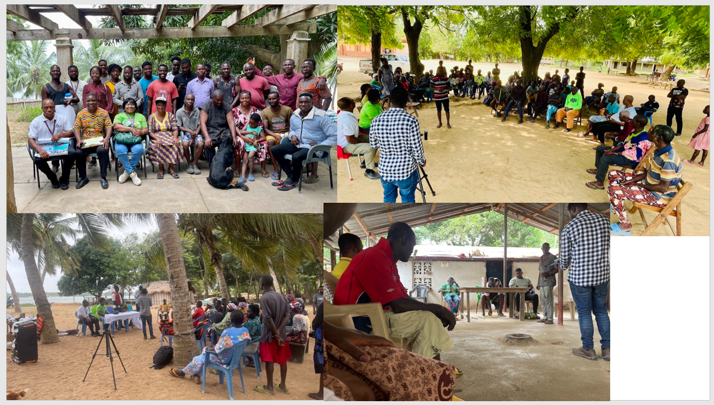
Community Engagement and Social Mobilization
Notes:
For community buy-in

Slide 15
Execution & Performance
Baseline Studies
Mass Drug Administration
Participatory Monitoring
Evaluation
Add mark here

Slide 16
No. of Persons Examined
No. of Females Examined
No. of Males Examined
No. Diagnosed Positive
Baseline Avg. Prevalence
8,296
4,339
3,957
3,520
42.43%
Baseline by District and Gender
2024 Baseline Avg. Prevalence By District
Baseline Results By Gender & Age Group
Notes:
Baseline Studies

Slide 17
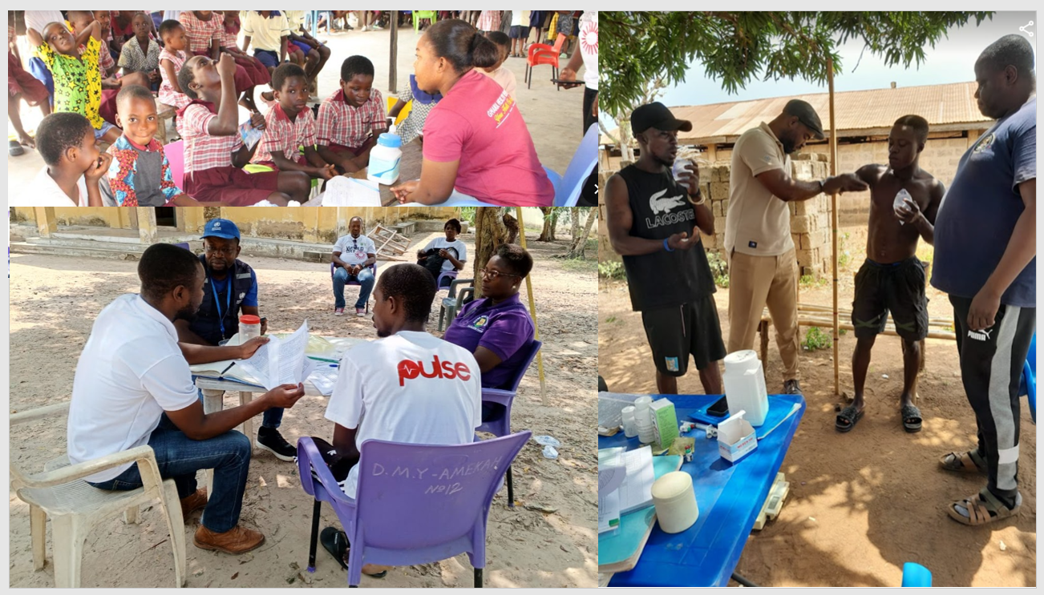
MDA

Slide 18
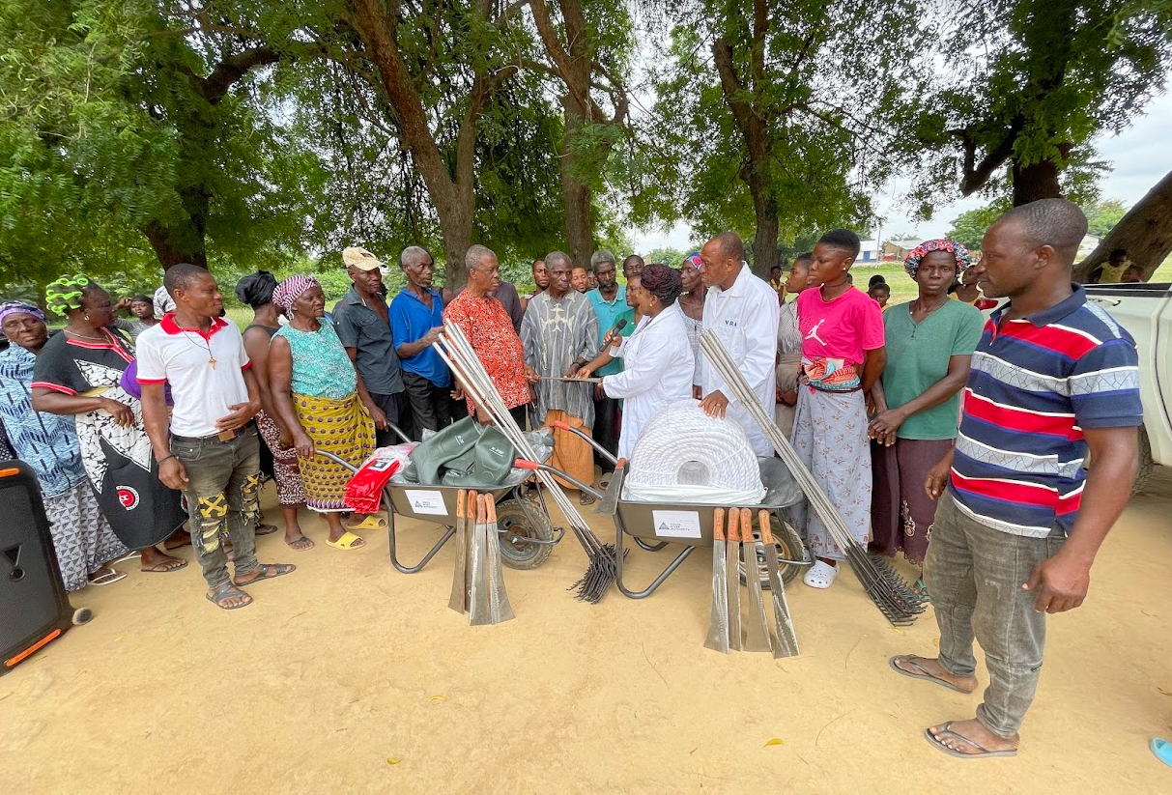
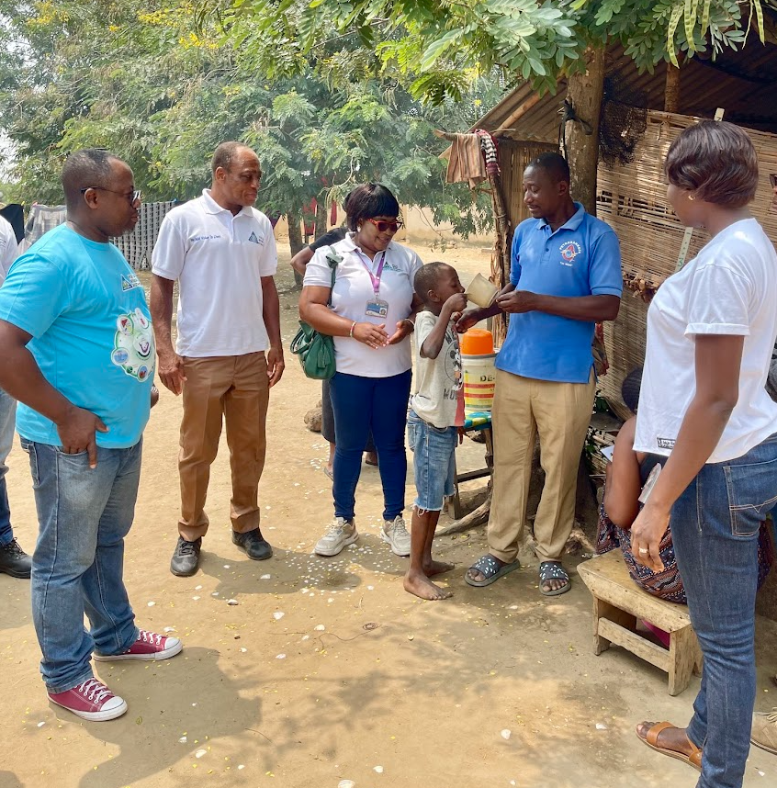
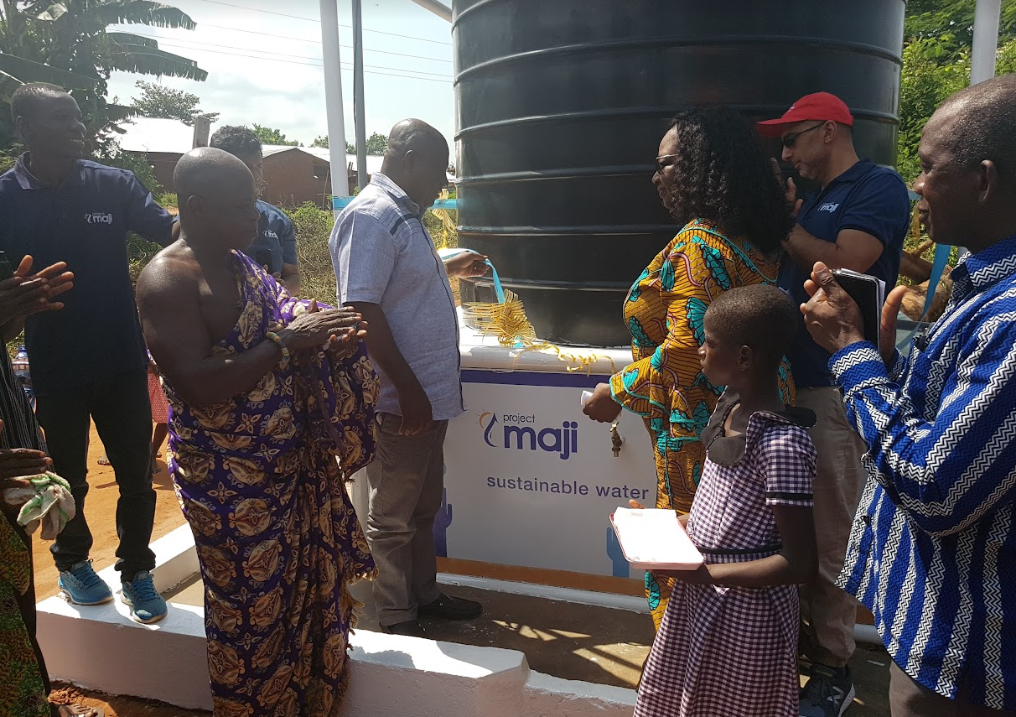
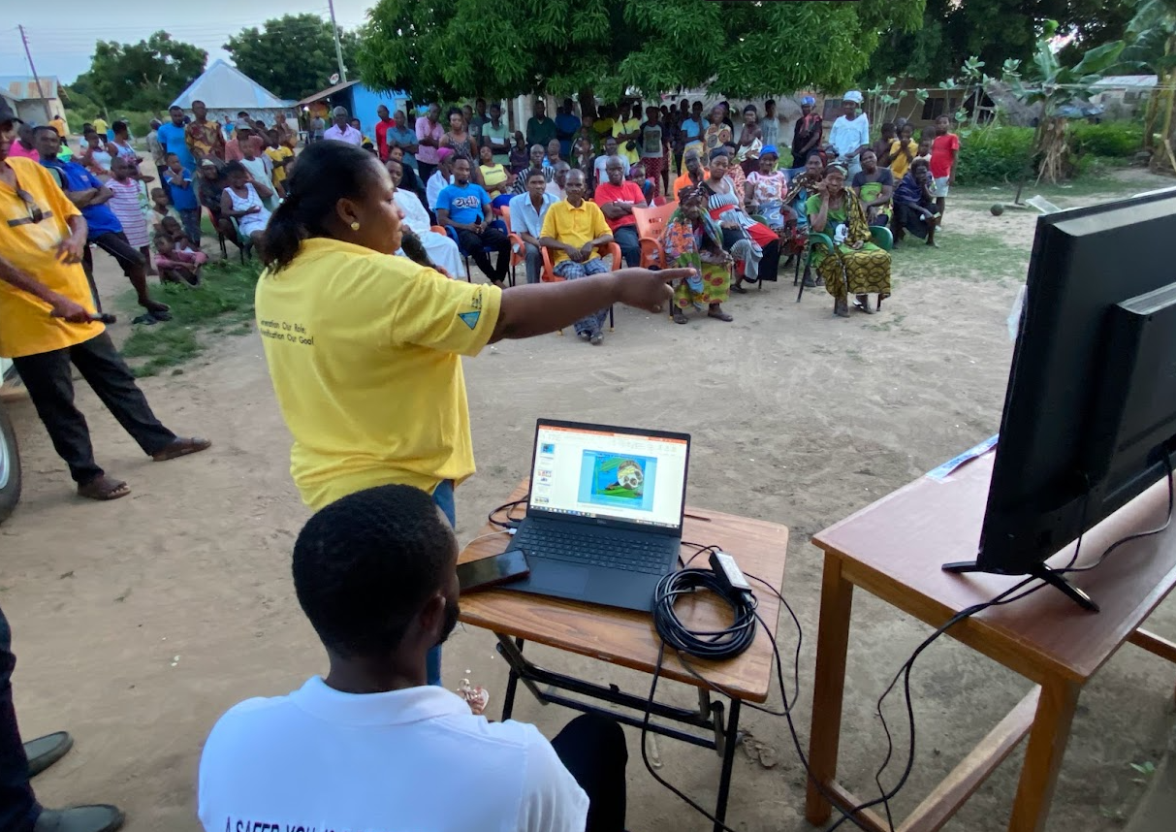
Snail Vector Control
Mass Drug Administration
Provision of Water & Sanitation Facilities
Awareness Creation

Slide 19
Risks & Quality Management
MDA possible side effects managed by trained health personnel
VRA focused on operations, prevalence assessments & data management
Safety protocols integrated
Enhanced trust from communities
Add mark here

Slide 20
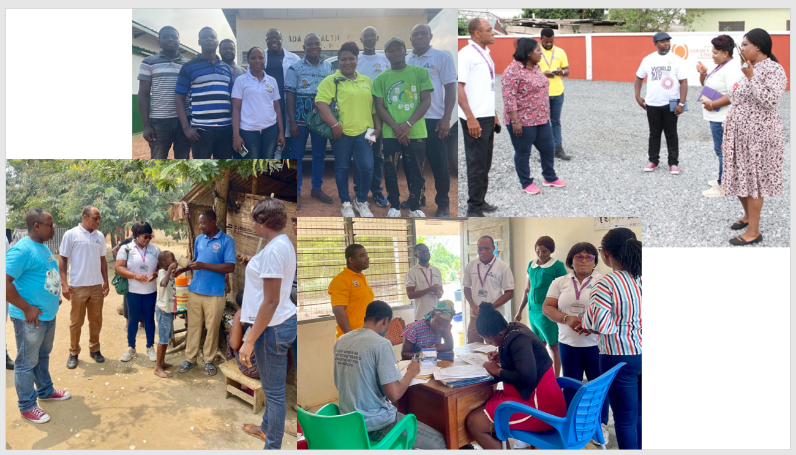
Participatory Monitoring by Stakeholders

Slide 21
No. of Persons Examined
No. of Females Examined
No. of Males Examined
No. Diagnosed Positive
Evaluation Prevalence
5,324
2,570
2,754
248
4.66%
Evaluation by District and Gender
2024 Evaluation Avg. Prevalence By District
Evaluation Results By Gender & Age Group

Slide 22
Notes:
Results that Matter; Our Measurable Impact

Slide 23






MDA
Our Measurable Impact
Evaluation
19,714 (25,403)
No. Evaluated
5,324
📉 Prevalence Rate: 42.43% → 4.66%
👥 Annual Reach: 4,000 → 25,000+
⏱ Delivery Time: Months → 1 Week
No. Positive = 186
No. Treated
No. Positive = 186
No. Praziquantel Tablets used
No. Positive
248
57,374.5
Males = 9,310
Ada
42.73 %
6.21 %
Males = 135
Females = 10,404
Shai
39.84 %
4.85 %
Females = 113

Slide 24
Regional Summary of 2024 MDA and Evaluation Activities
 | Treatment |  |  |  | Evaluation |  |  | Positive Cases |  |  | Prevalence Rate (%)
Region | Females | Males | Total | Total Pzq. | Examined | Females | Males | No. Pos | Females | Males | Current Prev. | Baseline Prev. | % Change
Greater Accra | 3,979 | 3,528 | 7,507 | 21,348 | 2,444 | 1,199 | 1,245 | 133 | 58 | 75 | 5.44 | 41.20 | -86.80
Volta | 6,425 | 5,779 | 12,204 | 36,015 .5 | 2,349 | 1,136 | 1,213 | 86 | 41 | 45 | 3.66 | 40.11 | -90.88
Eastern* |  | 3 | 3 (5,689) | 11 | 531 | 235 | 296 | 29 | 14 | 15 | 5.47 | 60.53 | -90.96
Grand Total | 10,404 | 9,310 | 19,714 (25,403) | 57,374.5 | 5,324 | 2,570 | 2,754 | 248 | 113 | 135 | 4.66 | 42.43 | -89.02

Slide 25

Communication & Monitoring
In-person and virtual meetings, emails, status reports and telephone conversations
Schistosomiasis Jingle by AIS, Radio and Community Information Centers (CICs),
Pull-up banners, posters and fliers.

Slide 26
Digital Innovation in Action
App developed; Tablets procured to replace manual data entry
Digitizing Field Data gathering and analysis for Real-Time Decisions
Transition from huge manual paper records to a digital platform
Add mark here
Notes:
Digitalization of Data Gathering process for easy Analysis

Slide 27
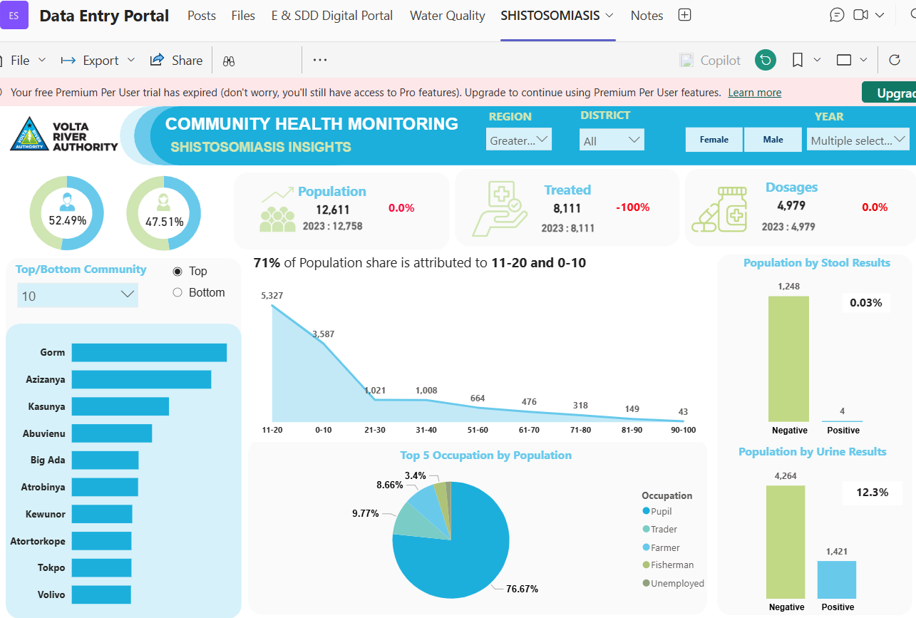
Made
possible
by an
internal
Cross Functional Team of Digital Transformers, IT, Public Health and Environmental Expects
Notes:
Digital interface and platform enabling you to track disease prevalence down to the individual level

Slide 28
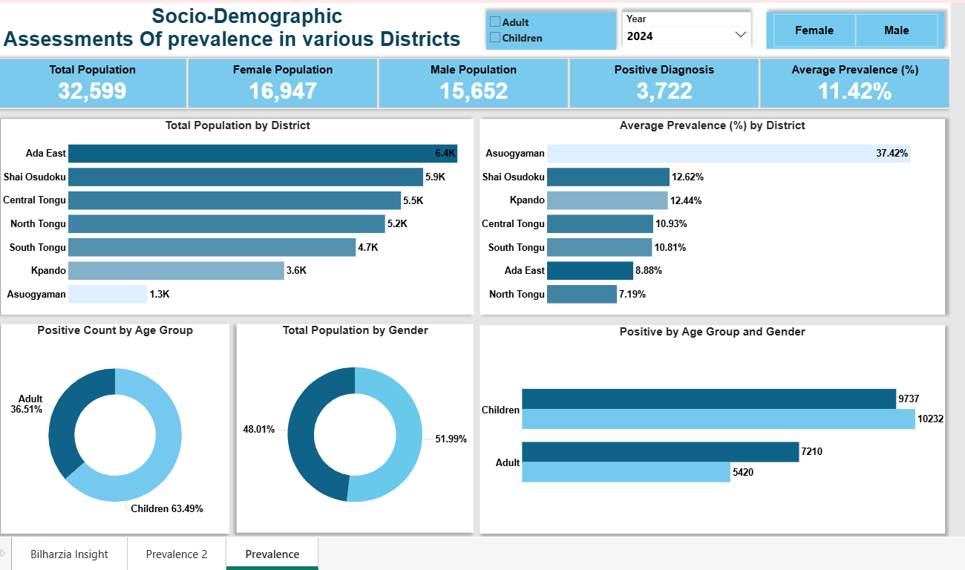
Notes:
Interactive Dashboards of huge datasets produced in seconds

Slide 29
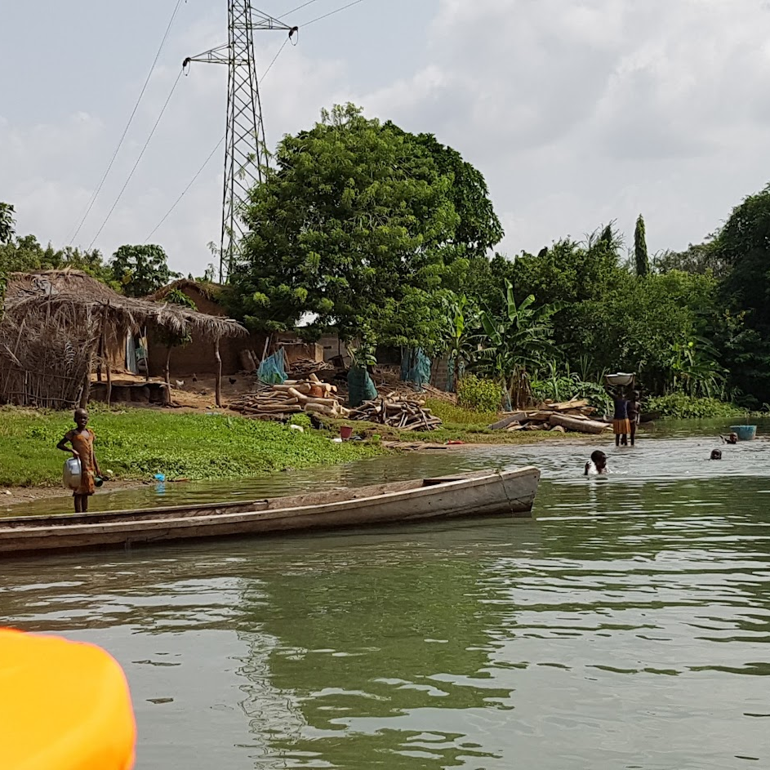
Schedule and
Cost Management
Took just days to complete what would have taken months
Treated 5 times more people annually
Notes:
Time is money. But time in public health is lives saved.

Slide 30
Conclusion & Call to Action
Lessons for Project Leaders
Treat public health like a project
Don’t work alone; strategic partnerships = scale
Digital tools are no longer optional
Role clarity reduces risk and avoids role ambiguity
Document everything – impact should outlive the project team
Public health is a viable PM frontier
Let’s continue to build and innovate – for life, not just infrastructure
VRA’s model is scalable; across Africa, and beyond
Notes:
To avoid role ambiguity.

Slide 31
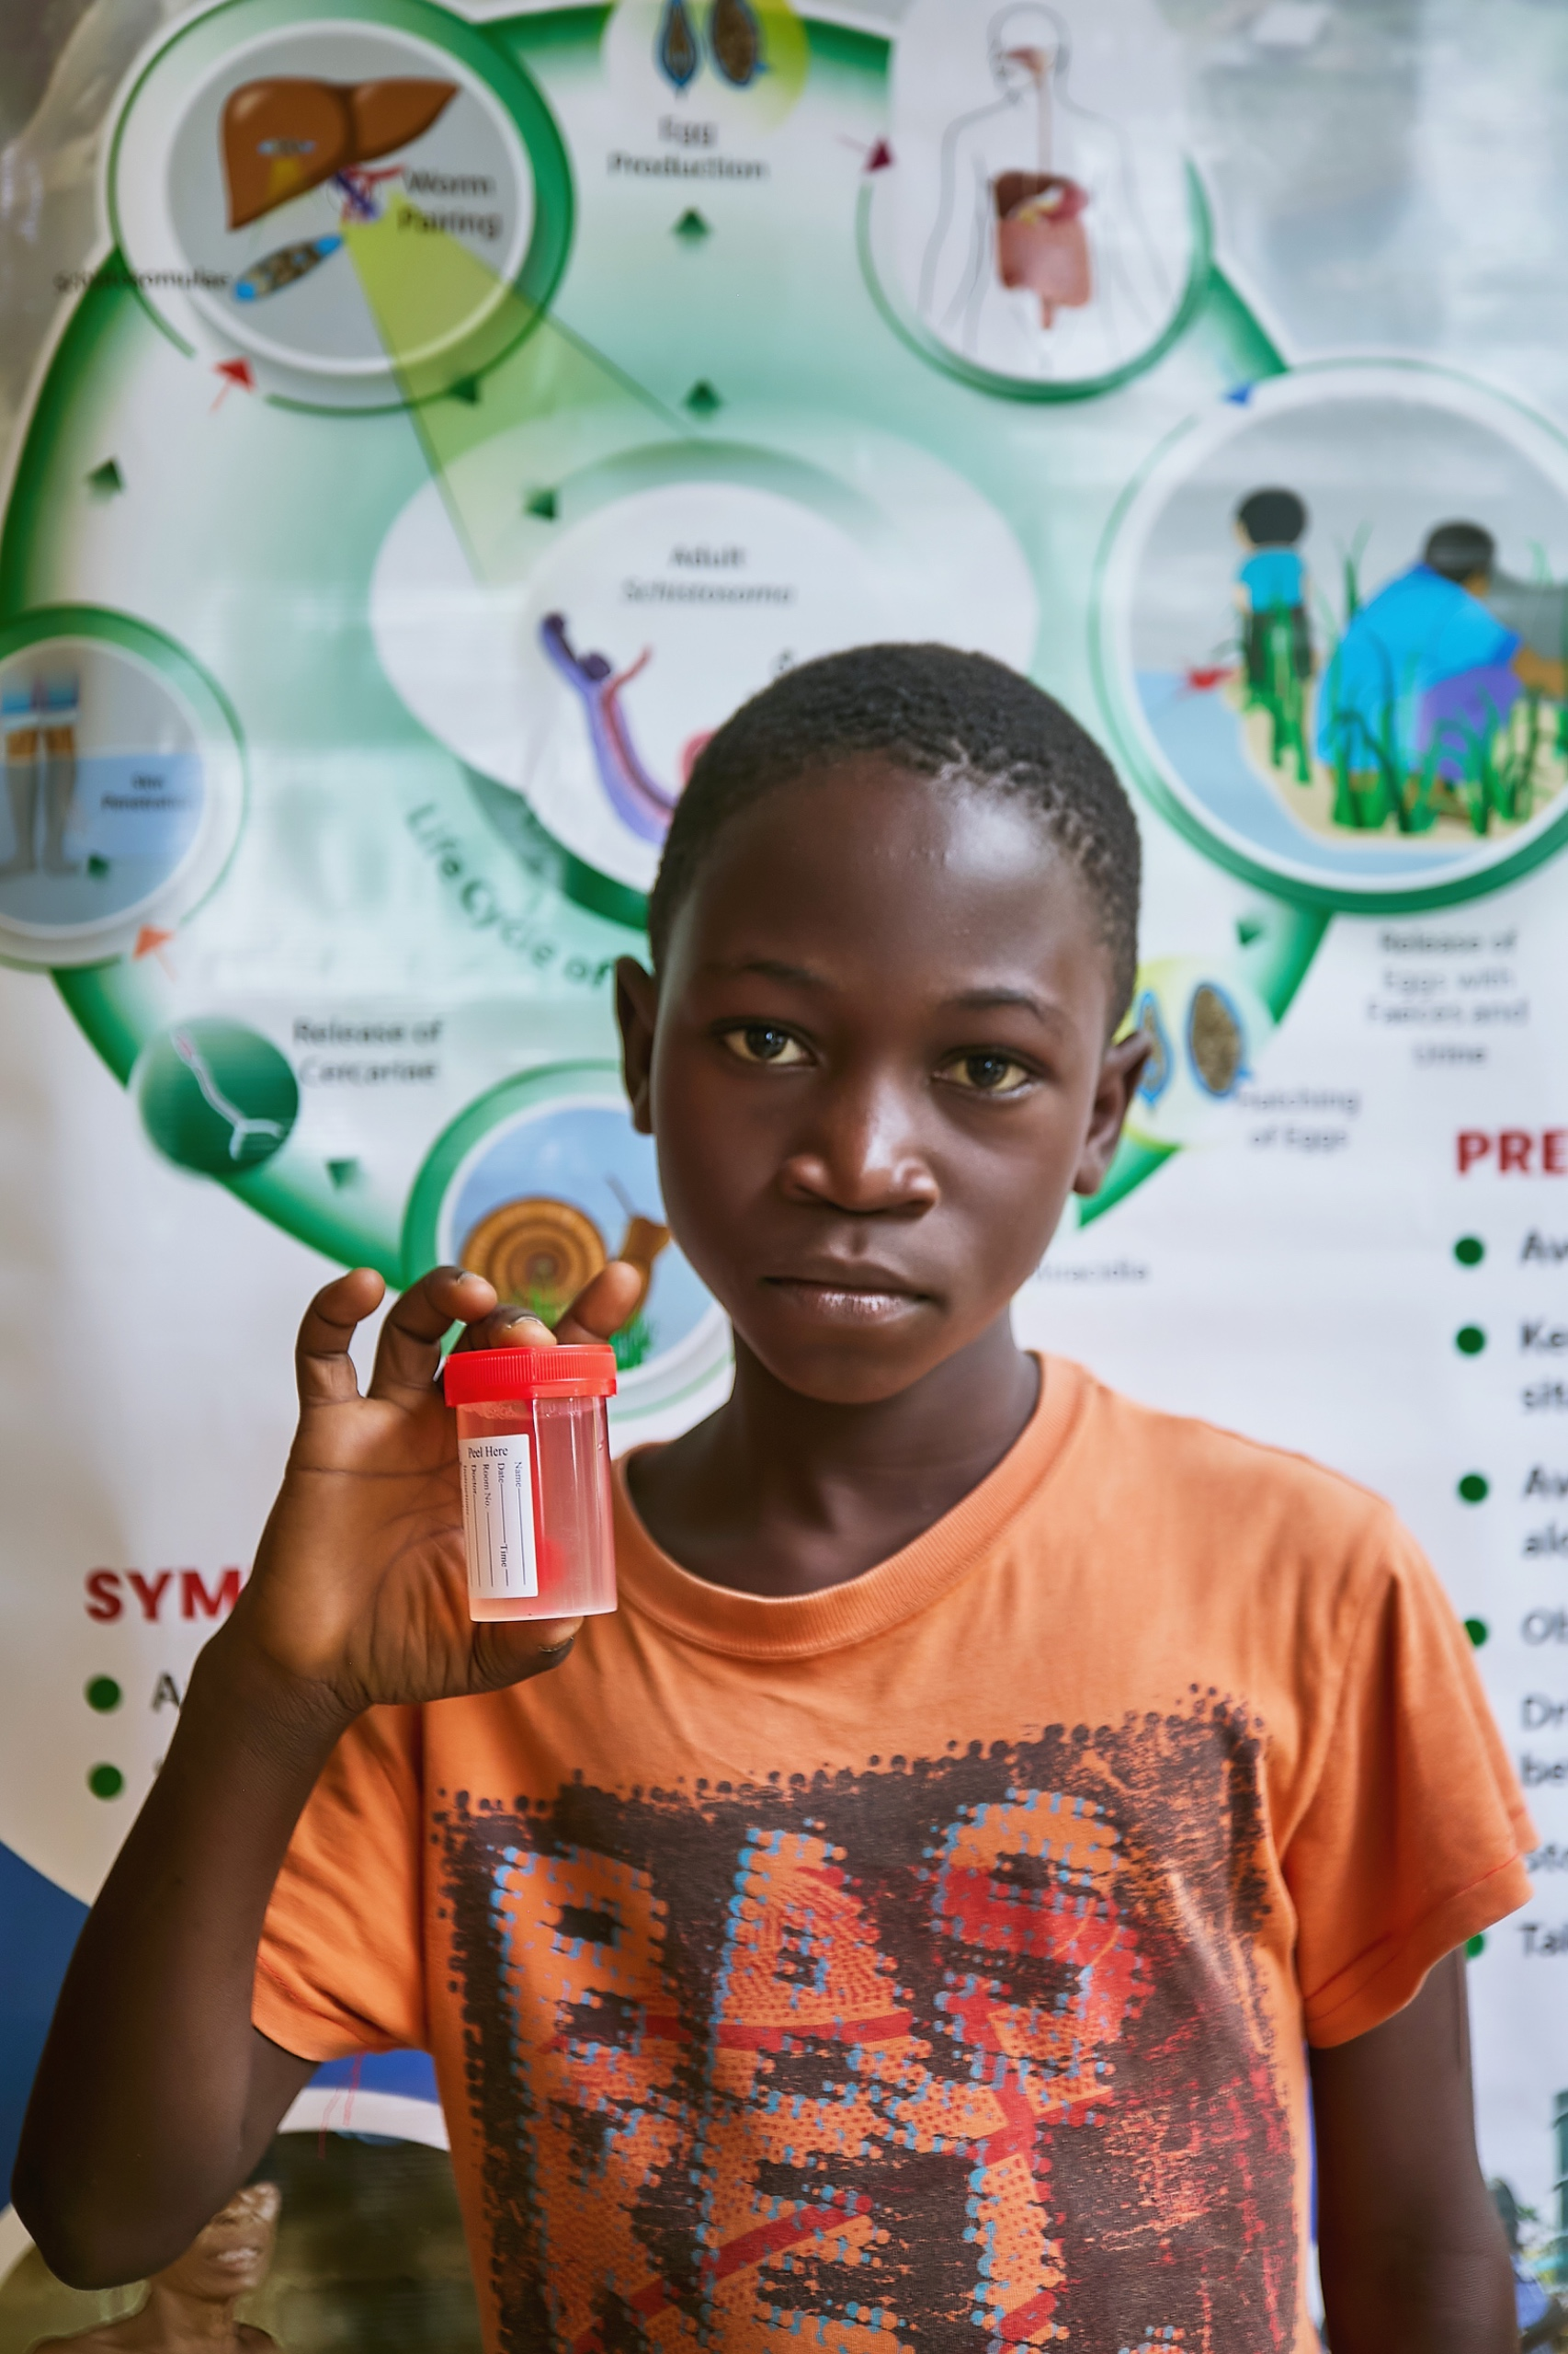

“
Our work improved lives, not just because we cared, but because we managed it like a mission-critical project.
“
Ben Sackey, Director, E&SDD, VRA
Notes:
VRA, We Add Value To Lives…

